Slide 1
Chapter 3
How to use HTML to structure a web page
Murach's HTML and CSS, 5th Edition
© 2022, Mike Murach & Associates, Inc.

Slide 2
Objectives
Applied
Code a properly structured HTML web page using the semantic elements and any of the other elements that are presented in this chapter.
Given the folder structure for a website, code a relative URL that refers to any file in that structure.
Knowledge
Describe the use of the title and meta elements in the head section of an HTML document.
Distinguish between a block element and an inline element.
Describe the use of these block elements: h1, h2, h3, and p.
Describe the use of these semantic elements: header, main, section, article, nav, aside, footer, and figure.
Murach's HTML and CSS, 5th Edition
© 2022, Mike Murach & Associates, Inc.

Slide 3
Objectives (continued)
Describe the use of the div element in the HTML for a modern website.
Describe the use of these inline elements: q, em, strong, sub, sup, span.
Describe the use of character entities like &nbsp; or &copy;.
Distinguish between absolute and relative URLs, and distinguish between root-relative and document-relative paths
Describe the use and accessibility guidelines for <a> elements.
Describe the two types of lists that you can create with HTML.
Describe the use and accessibility guidelines for img elements.
Murach's HTML and CSS, 5th Edition
© 2022, Mike Murach & Associates, Inc.

Slide 4
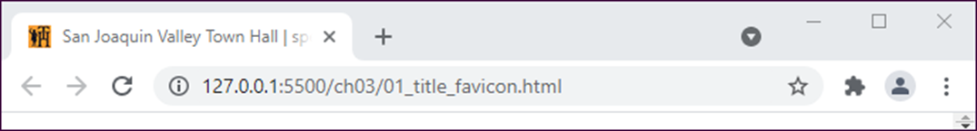
A browser that shows the title and favicon
A head section with a title and a link to a favicon
<head>
<title>San Joaquin Valley Town Hall | speakers and luncheons
</title>
<link rel="shortcut icon" href="favicon.ico">
</head>
Murach's HTML and CSS, 5th Edition
© 2022, Mike Murach & Associates, Inc.
Notes:
The head section of an HTML document contains elements that provide information about the web page rather than the content of the page. In chapter 1, for example, you learned that the title element sets the text that’s displayed in the tab for the page in the web browser. Now, you’ll learn more about this element as well as some other elements that you can code in the head section.
How to code the title element
The head section of every page should include a unique title element that describes the content of the page. In the HTML shown in figure 3-1, for example, you can see that this element gives the name of the organization followed by the keywords speakers and luncheons.
This title is used by search engines for search engine optimization, and it appears in the results of a search to help the users decide whether they want to go to that page. That’s why you should follow the SEO guidelines in this figure when you code this element.
The content of the title element is also displayed in the browser’s tab for the page. As you can see in this figure, though, only the portion of the title that fits in the tab is displayed. But if you hover the mouse over the tab, the entire title will be displayed in a tooltip.
How to link to a favicon
The link element is an optional element that you can use to specify a file that should be linked to the web page. In figure 3-1, the link element is used to link a custom icon, called a favicon, to the web page. This causes the icon to be displayed to the left of the title in the tab for the page. Note that you typically name this icon favicon.ico as shown in this figure. When you code the link element, you typically include two attributes.
The rel attribute indicates the relationship of the linked resource to the document. For a favicon, you use the value “shortcut icon”. The href attribute provides the URL of the resource. In this example, the favicon is in the same folder as the HTML file, so the URL is just the filename. If the file is in a different location, though, you can use an absolute or relative URL to identify that location.
You’ll learn how to code absolute and relative URLs later in this chapter. Note that when you deploy a website to a web server, it isn’t necessary to include a link element for the favicon. Instead, you can place the favicon in the root folder for the website and it will automatically appear in the tab for each page. In this book, though, we’ve included the link element so you can see the favicon as you develop a website on your own computer.

Slide 5
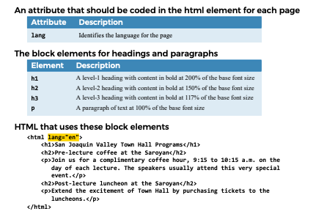
Murach's HTML and CSS, 5th Edition
© 2022, Mike Murach & Associates, Inc.
Notes:
How to present the contents of a web page
The next three figures show how to present the contents of a web page. That includes how to structure that content for web accessibility and search engine optimization.
How to code the lang attribute
Figure 3-2 starts by showing how to code the lang attribute that should identify the language for each of your web pages. To do that, you code the lang attribute for the html element of each page just as it’s shown. In this case, that attribute is set to “en” so English is the language.
How to code headings and paragraphs
Headings and paragraphs provide most of the text for a web page. They are defined by the HTML elements in the second table in figure 3-2. These elements are block elements, which means that they start on a new line when they are displayed.
In the example in this figure, you can see how these elements work. Here,
the HTML uses the h1, h2, and <p> elements to generate the text that’s shown. When these elements are displayed by a browser, each element has a default font and size that’s determined by the base font of the browser. This base font is typically Times New Roman in 16 pixels.
When you use the heading elements, the most important heading on a page should be an h1 element. You should only code one h1 element on each page.
And you should only go down one level at a time, not jump down two or more levels to indicate less importance. In other words, the first heading level after an h1 should be an h2, not an h3.
This structure helps search engines index your site, and it makes your pages more accessible to devices like screen readers. Incidentally, HTML provides for three more levels below h3 with tags that range from h4 through h6. However, you shouldn’t need these levels for the normal structure of a web page.

Slide 6
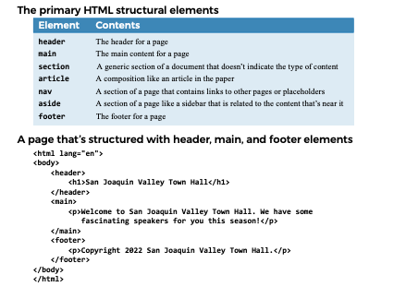
Murach's HTML and CSS, 5th Edition
© 2022, Mike Murach & Associates, Inc.
Notes:
How to code the structural elements
Figure 3-3 presents the structural elements that were introduced with HTML5. To illustrate, the example in this figure shows how the header, main, and footer elements can be used to divide a web page into three parts. Later, this structure makes it easy to use CSS to change the page layout and format the content. All of these structural elements are block elements. But unlike the heading and paragraph elements, you can nest other block elements within these structural elements. In the HTML code in this figure, for example, you can see that an h1 element is nested within the header element, and a <p> element is nested within both the main and footer elements.
Although this figure only illustrates the use of three of the seven elements in the table, you’ll see the nav element used in the web page at the end of this chapter. And in later chapters, you’ll see how the aside element is used for a sidebar within the main element; how the section element is used for other content within the main element; and how the article element is used for an article about a speaker.
But at this point, please note that all the HTML elements that you’ve learned about so far in this chapter have indicated the type of content they contain. For example, an h1 element identifies the top-level heading for a page, and the main element identifies the main content for a page. Elements like these are called semantic elements because they give meaning to their content, and the use of these elements can be referred to as HTML semantics. Semantics of course are good for both the developer and the browser. And that in turn means

Slide 7
A head section that includes metadata
<head>
<title>San Joaquin Valley Town Hall | speakers and luncheons
</title>
<meta charset="utf-8">
<meta name="description" content="A yearly lecture series with speakers that present new information on a wide range of subjects">
<meta name="keywords" content="san joaquin, town hall, speakers, lectures, luncheons">
</head>
Murach's HTML and CSS, 5th Edition
© 2022, Mike Murach & Associates, Inc.
Notes:
How to include metadata
The meta element is another optional element that you can code within the head element. You use it to specify metadata, which provides information about the content of the document.
The head element in figure 3-2 includes three meta elements. The first one specifies the character encoding used for the page, and UTF-8 is the encoding that’s commonly used for the World Wide Web. Since this element is required for HTML5 validation, you should include it in the head section of every HTML document, and it should be one of the first elements in the head section.
The next two meta elements in this figure provide metadata that can be used by search engines to index the page. Here, the first element uses the name attribute with the value “description” to indicate that the content attribute that follows contains a description of the web page.
This can be a longer description than the one in the title element, and it should also be unique for each page in your website.
The second meta element uses the name attribute with the value “keywords” to indicate that the content attribute contains a list of keywords related to the page. At one time, the keywords were an important factor for search engine optimization. However, Google and Bing no longer use the keywords, although other search engines like Yahoo may. This is partly due to the fact that some web masters used keywords to misrepresent what a page contained. Because the algorithms that search engines use are changed frequently, it’s
hard to know what the best use of metadata is. There is also the danger that you might change the content of a page and forget to change the metadata. In that case, a search engine might index the page incorrectly. Nevertheless, it’s still a good practice to provide at least the description metadata for the important pages of a website. Just make sure that the description match the contents of your data.

Slide 8
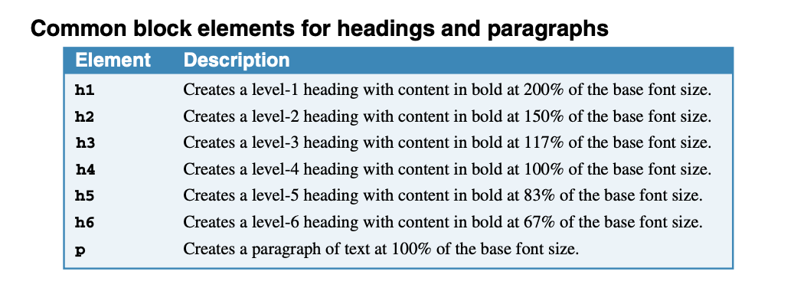
Murach's HTML and CSS, 5th Edition
© 2022, Mike Murach & Associates, Inc.
Notes:
How to code text elements
Within the body of a document, you can code two types of elements: block elements and inline elements. In the topics that follow, you’ll learn how to code a variety of block and inline elements that define the text for a document.
How to code headings and paragraphs
Headings and paragraphs are the most common content of a web page. These are defined by the HTML elements shown in figure 3-3. These elements are called block elements, and each one begins on a new line when it is displayed.
If you review the example in this figure, you shouldn’t have any trouble understanding how these elements work. Here, the HTML uses the h1, h2, and <p> elements to generate the text that’s shown. When these elements are displayed by a browser, each element has a default font and size that’s deter-mined by the base font of the browser. This base font is typically Times New Roman in 16 pixels.
When you use the h1 through h6 elements, you should use them to provide a logical structure for your document, not to format the text. That means that the most important heading on a page should always be an h1 element, and you should only code one h1 element on each page.
That also means you should only go down one level at a time, not jump down two or more levels to indicate less importance. In other words, the first heading level after an h2 should be an h3, not an h4.
For example, the h1 element in this figure is used to mark the most important heading on the page, and the h2 elements are used to mark the next level of importance. Then, if the first h2 element required two subheadings below it, they would both be coded at the h3 level.
This structure helps search engines index your site properly, and it makes your pages more accessible to devices like screen readers. Then, you can use CSS to size and format the text in these elements, as shown in the next chapter.

Slide 9
SEO guidelines for the title tag
Always code a title tag in the head section.
The title should accurately describe the page’s content.
The title should include the one or two focus keywords that you want to be used for ranking the page.
The title should be interesting enough to entice the reader to click on it when it’s shown in the search results for a search engine.
The title should be unique for each page in your website.
Limit the length of your titles to around 65 characters because most search engines don’t display more than that in their results.
Murach's HTML and CSS, 5th Edition
© 2022, Mike Murach & Associates, Inc.

Slide 10
SEO guidelines for the meta tags
Code the description metadata for each page of your website.
The description should summarize the contents of the page, it should be unique for each page, and it can be longer than the title tag.
When the description is displayed in the search-engine results, it should encourage users to click on your link.
Murach's HTML and CSS, 5th Edition
© 2022, Mike Murach & Associates, Inc.

Slide 11
HTML that uses block elements
<h1>San Joaquin Valley Town Hall Programs</h1>
<h2>Pre-lecture coffee at the Saroyan</h2>
<p>Joins us for a complimentary coffee hour, 9:15 to 10:15 a.m. on the day of each lecture. The speakers usually attend this very special event.</p>
<h2>Post-lecture luncheon at the Saroyan</h2>
<p>Extend the excitement of Town Hall by purchasing tickets to the luncheons</p>
Murach's HTML and CSS, 5th Edition
© 2022, Mike Murach & Associates, Inc.
Notes:
Here, the HTML uses the h1, h2, and <p> elements to generate the text that’s shown. When these elements are displayed by a browser, each element has a default font and size that’s deter-mined by the base font of the browser.
This base font is typically Times New Roman in 16 pixels.
When you use the h1 through h6 elements, you should use them to provide a logical structure for your document, not to format the text. That means that the most important heading on a page should always be an h1 element, and you should only code one h1 element on each page.
That also means you should only go down one level at a time, not jump down two or more levels to indicate less importance. In other words, the first heading level after an h2 should be an h3, not an h4. For example, the h1 element in this figure is used to mark the most important heading on the page, and the h2 elements are used to mark the next level of importance.
Then, if the first h2 element required two subheadings below it, they would both be coded at the h3 level. This structure helps search engines index your site properly, and it makes your pages more accessible to devices like screen readers. Then, you can use CSS to size and format the text in these elements, as shown in the next chapter.

Slide 12
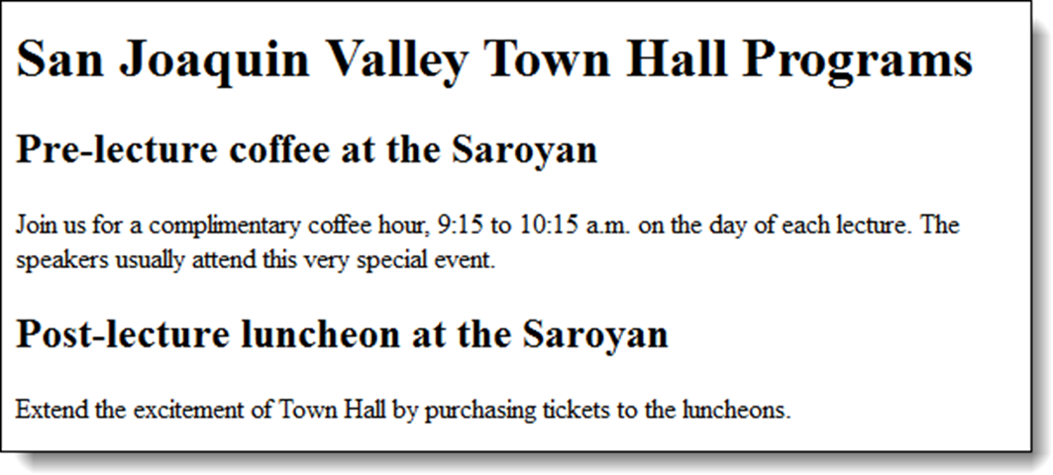
The block elements in a web browser
Murach's HTML and CSS, 5th Edition
© 2022, Mike Murach & Associates, Inc.

Slide 13
SEO guidelines for heading tags
Use the heading tags to show the structure and importance of the content on a page.
Always use the h1 tag to identify the most important information on the page, and only code a single h1 tag on each page.
Then, decrease one level at a time to show subsequent levels of importance.
Don’t use heading levels as a way to size text. Instead, use CSS to size the headings.
Murach's HTML and CSS, 5th Edition
© 2022, Mike Murach & Associates, Inc.

Slide 14
An HTML page with structural elements
<body>
<header>
<h1>San Joaquin Valley Town Hall</h1>
</header>
<main>
<p>Welcome to San Joaquin Valley Town Hall. We have some fascinating speakers for you this season!</p>
</main>
<footer>
<p>&copy; Copyright 2022 San Joaquin Valley Town Hall.</p>
</footer>
</body>
Accessibility and SEO guideline
Use the HTML structural elements to indicate the structure of your pages.
Murach's HTML and CSS, 5th Edition
© 2022, Mike Murach & Associates, Inc.
Notes:
How to code the structural elements
Figure 3-3 presents the structural elements that were introduced with HTML5. To illustrate, the example in this figure shows how the header, main, and footer elements can be used to divide a web page into three parts. Later, this structure makes it easy to use CSS to change the page layout and format the content. All of these structural elements are block elements. But unlike the heading and paragraph elements, you can nest other block elements within these structural elements. In the HTML code in this figure, for example, you can see that an h1 element is nested within the header element, and a <p> element is nested within both the main and footer elements.
Although this figure only illustrates the use of three of the seven elements in the table, you’ll see the nav element used in the web page at the end of this chapter. And in later chapters, you’ll see how the aside element is used for a sidebar within the main element; how the section element is used for other content within the main element; and how the article element is used for an article about a speaker.
But at this point, please note that all the HTML elements that you’ve learned about so far in this chapter have indicated the type of content they contain. For example, an h1 element identifies the top-level heading for a page, and the main element identifies the main content for a page.

Slide 15
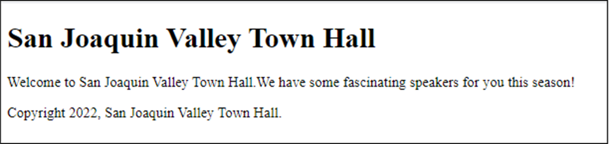
The page displayed in a web browser
Murach's HTML and CSS, 5th Edition
© 2022, Mike Murach & Associates, Inc.
Notes:
Elements like these are called semantic elements because they give meaning to their content, and the use of these elements can be referred to as HTML semantics. Semantics of course are good for both the developer and the browser. And that in turn means

Slide 16
How to use div elements to structure the content within a section
<section>
<div>
<h2>The first priority</h2>
<p>The elements for the first priority</p>
</div>
<div>
<h2>The second priority</h2>
<p>The elements for the second priority</p>
</div>
</section>
Murach's HTML and CSS, 5th Edition
© 2022, Mike Murach & Associates, Inc.
Notes:
When and how to use div elements
But what happens if you want to divide one of the structural elements into two or more parts and there isn’t a semantic element for that? Then, you can use div elements as shown in figure 3-4. Here, the first example shows how two div elements can be used to divide a section element into two divisions. Then, you can use CSS to lay out and format these divisions separately.

Slide 17
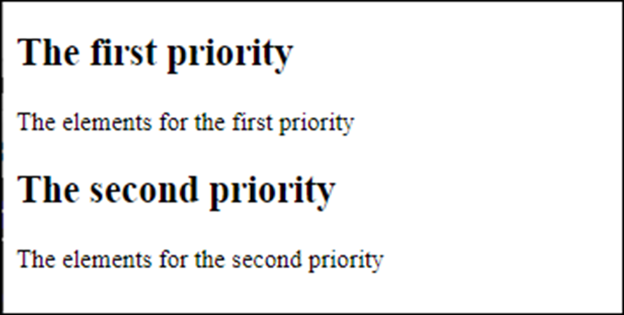
The resulting web page
Murach's HTML and CSS, 5th Edition
© 2022, Mike Murach & Associates, Inc.

Slide 18
How div elements were used before HTML5
<body>
<div id="header">
<h1>San Joaquin Valley Town Hall</h1>
</div>
<div id="main">
<p>Welcome to San Joaquin Valley Town Hall.</span> We have some fascinating speakers for you this season!</p>
</div>
<div id="footer">
<p>&copy; Copyright 2015 San Joaquin Valley Town Hall.</p>
</div>
</body>
Accessibility and SEO guidelines
Only use div tags when the HTML semantic elements don’t apply.
Murach's HTML and CSS, 5th Edition
© 2022, Mike Murach & Associates, Inc.
Notes:
The second example in this figure shows how div elements were used before HTML5 introduced the structural elements. Here, you can see that the div elements divide the page into header, main, and footer divisions by using id attributes to identify them. But the div elements aren’t semantic and don’t help web accessibility or search engine optimization. That’s why you don’t want to use div elements when you can use the structural elements.

Slide 19
HTML that uses inline elements to identify and format text
<p>When the dialog box is displayed, enter <kbd>brock21</kbd>.</p>
<p>To quote Hamlet:
<q>Conscience does make cowards of us all.</q>
</p>
<p>If you don't get 78% or more on your final, <em>you won't pass.</em></p>
<p>Save a bundle at our <strong>big yearend sale</strong>.</p>
<p>The chemical symbol for water is H<sub>2</sub>O.</p>
Murach's HTML and CSS, 5th Edition
© 2022, Mike Murach & Associates, Inc.
Notes:
The next two figures show how to use inline elements, other block elements, and character entities to present the text for a web page.

Slide 20
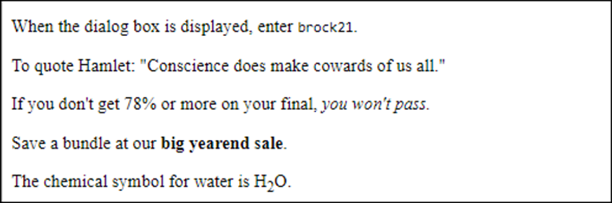
The inline elements in a web browser
Murach's HTML and CSS, 5th Edition
© 2022, Mike Murach & Associates, Inc.

Slide 21
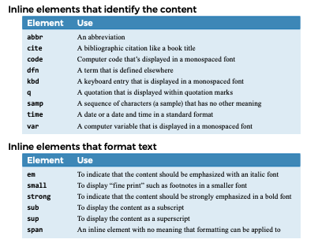
Murach's HTML and CSS, 5th Edition
© 2022, Mike Murach & Associates, Inc.
Notes:
How to code the inline elements for text
In contrast to a block element, an inline element doesn’t start on a new line. Instead, an inline element is coded within a block element. In figure, 3-5, you can see how 14 inline elements can be used to provide and format the text for a web page.
The first table in this figure presents elements that you can use to identify inline content. For instance, you can use the abbr element to identify an abbreviation, the <q> element to identify a quotation, and the cite element to identify the source of a block element like a quotation.

Slide 22
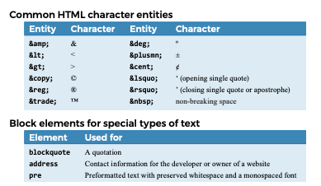
Murach's HTML and CSS, 5th Edition
© 2022, Mike Murach & Associates, Inc.

Slide 23
HTML that uses block elements and character entities
<p>Ernest Hemingway wrote:</p>
<blockquote>
Cowardice, as distinguished from panic, is almost
always simply a lack of ability to suspend
the functioning of the imagination.
</blockquote>
<address>1-800-221-5528<br>
<a href="emailto:murachbooks@murach.com">
murachbooks@murach.com</a>
</address>
<p>&copy; 2022 Mike Murach &amp; Associates, Inc.</p>
Murach's HTML and CSS, 5th Edition
© 2022, Mike Murach & Associates, Inc.
Notes:
How to use character entities and three block elements for text
Figure 3-6 shows how to use character entities and three more block elements for text. In the first table, you can see 12 of the many character entities that provide a way to include characters like ampersands (&) and degree symbols in your text. As you can see, all character entities start with an ampersand (&) and end with a semicolon (;). Then, the rest of the entity identifies the character it represents.
In the second table, you can see three more block elements for coding special types of text. For instance, the blockquote element can be used to display a quotation, and the address element can be used to present contact information.
Like the structural elements, these elements are good semantically because they identify the contents.
The examples that follow illustrate how character entities and these block elements work. Here, the blockquote element is used for a quotation, but note that quotation marks aren’t added to it. Then, the address element is used for contact information.
Last, two character entities are used within a <p> element. The first one provides the copyright symbol. The second one provides an ampersand. This shows that you can’t just type an ampersand in your text because the ampersand is the first character in a character entity.
Similarly, because the left bracket (<) and right bracket (>) are used to identify HTML tags, you can’t use those characters to represent less-than and greater-than signs. Instead, you need to use the &lt; and &gt; entities. You should know, however, that in some cases the &, <, and > characters will work without coding them as character entities. If you want them to work for all purposes and pass all validation tests, though, it’s best to code them as character entities.

Slide 24
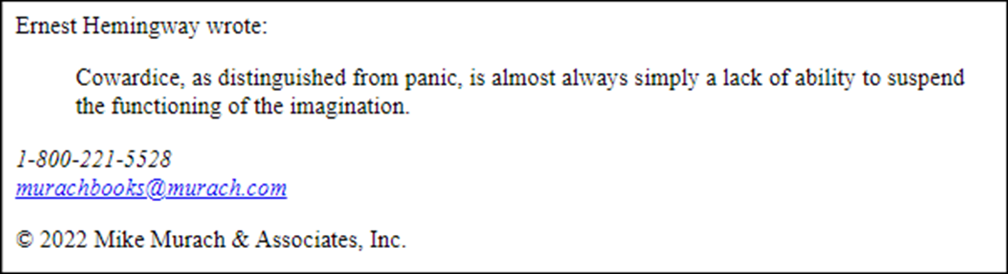
The block elements and character entities in a web browser
Murach's HTML and CSS, 5th Edition
© 2022, Mike Murach & Associates, Inc.

Slide 25
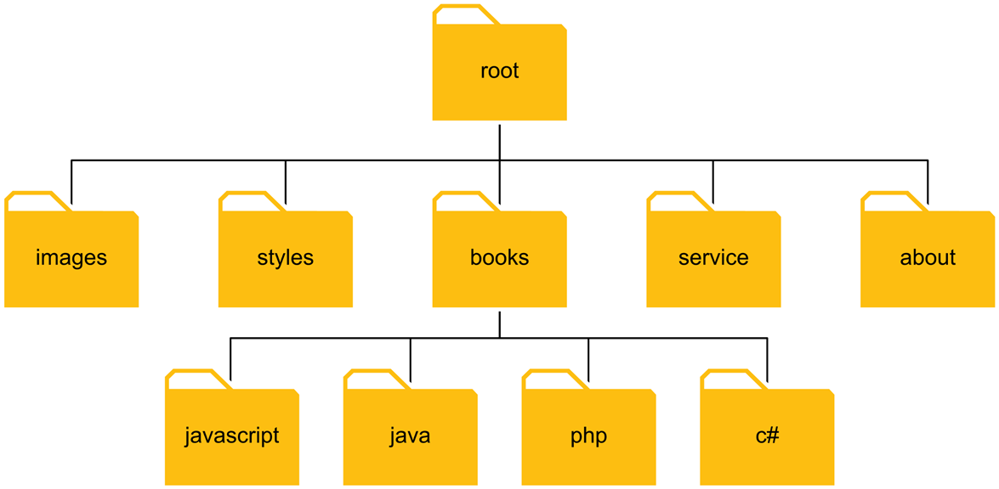
A simple website folder structure
Murach's HTML and CSS, 5th Edition
© 2022, Mike Murach & Associates, Inc.
Notes:
How to code links, lists, and images
Because you’ll use links, lists, and images in most of the web pages that you develop, the topics that follow introduce you to these elements. But first, you need to know how to code absolute and relative URLs so you can use them with your links and images.
How to code URLs
Figure 3-7 presents some examples of absolute and relative URLs. To help you understand how these examples work, the diagram at the top of this figure shows the folder structure for the website used in the examples. As you can see, the folders are organized into three levels. The root folder for the site contains five subfolders, including the folders that contain the images and styles for the site.
Then, the books folder contains subfolders of its own. In chapter 1, you learned the basic components of an absolute URL, which includes the domain name of the website.

Slide 26
Working with URLs and paths
Absolute URLs
http://www.murach.com/index.html
http://www.murach.com/books/php/toc.html
Root-relative paths
/login.html
/images/logo.gif
Document-relative paths that navigate down
images/logo.gif
books/php/overview.html
Document-relative paths that navigate up
../index.html
../images/logo.gif
Murach's HTML and CSS, 5th Edition
© 2022, Mike Murach & Associates, Inc.
Notes:
This is illustrated by the first group of examples in this figure. Here, both URLs refer to pages at www.murach.com. The first URL points to the index.html file in the root folder of this website, and the second URL points to the toc.html file in the root/books/php folder. When used within the code for the web pages of a site, an absolute URL is used to refer to a file in another website. By contrast, a relative URL is used to refer to a file within the same website. And as this figure shows, there are two types of relative URLs. In a root-relative path, the path is relative to the root folder of the website. This is illustrated by the second group of examples. Here, the leading slash indicates the root folder for the site.
As a result, the first path refers to the login.html file in the root folder, and the second path refers to the logo.gif file in the images folder. In a document-relative path, the path is relative to the current document. This is illustrated by the third group of examples. Here, the assumption is that the paths are coded in a file that is in the root folder for a website. Then, the first path refers to a file in the images subfolder of the root folder, and the second path refers to a file in the php subfolder of the books subfolder. This illustrates paths that navigate down the levels of the folder structure. But you can also navigate up the levels with a document-relative path. This is illustrated by the fourth group of examples. Here, the assumption is that the current document is in the root/books folder. Then, the first path goes up one level for the index.html file in the root folder. The second path also goes up one level to the root folder and then down one level for the logo.gif file in the images folder.
This shows that there’s more than one way to code the path for a file. If, for example, you’re coding an HTML file in the root/books folder, you can use either a root-relative path or a document-relative path to get to the images subfolder. If this is confusing right now, you’ll get used to it when you start coding your own pages.

Slide 27
Link examples
A link to a web page in the same folder
<p>Go view our <a href="products.html"> product list</a>.</p>
A link to a web page in a subfolder of the parent folder
<p>Read about the <a href="../company/services.html"> services we provide</a>.</p>
A link to a web page based on the root folder
<p>View your <a href="/orders/cart.html"> shopping cart</a>.</p>
A link to a web page at another website
<p>To learn more about JavaScript, visit the
<a href="http://www.javascript.com/"> official JavaScript web site</a>.</p>
Murach's HTML and CSS, 5th Edition
© 2022, Mike Murach & Associates, Inc.
Notes:
This is illustrated by the first group of examples in this figure. Here, both URLs refer to pages at www.murach.com.
The first URL points to the index.html file in the root folder of this website, and the second URL points to the toc.html file in the root/books/php folder. When used within the code for the web pages of a site, an absolute URL is used to refer to a file in another website.
By contrast, a relative URL is used to refer to a file within the same website. And as this figure shows, there are two types of relative URLs. In a root-relative path, the path is relative to the root folder of the website.
This is illustrated by the second group of examples. Here, the leading slash indicates the root folder for the site. As a result, the first path refers to the login.html file in the root folder, and the second path refers to the logo.gif file in the images folder. In a document-relative path, the path is relative to the current document. This is illustrated by the third group of examples. Here, the assumption is that the paths are coded in a file that is in the root folder for a website.
Then, the first path refers to a file in the images subfolder of the root folder, and the second path refers to a file in the php subfolder of the books subfolder. This illustrates paths that navigate down the levels of the folder structure. But you can also navigate up the levels with a document-relative path. This is illustrated by the fourth group of examples. Here, the assumption is that the current document is in the root/books folder. Then, the first path goes up one level for the index.html file in the root folder. The second path also goes up one level to the root folder and then down one level for the logo.gif file in the images folder.
This shows that there’s more than one way to code the path for a file. If, for example, you’re coding an HTML file in the root/books folder, you can use either a root-relative path or a document-relative path to get to the images subfolder. If this is confusing right now, you’ll get used to it when you start coding your own pages.

Slide 28
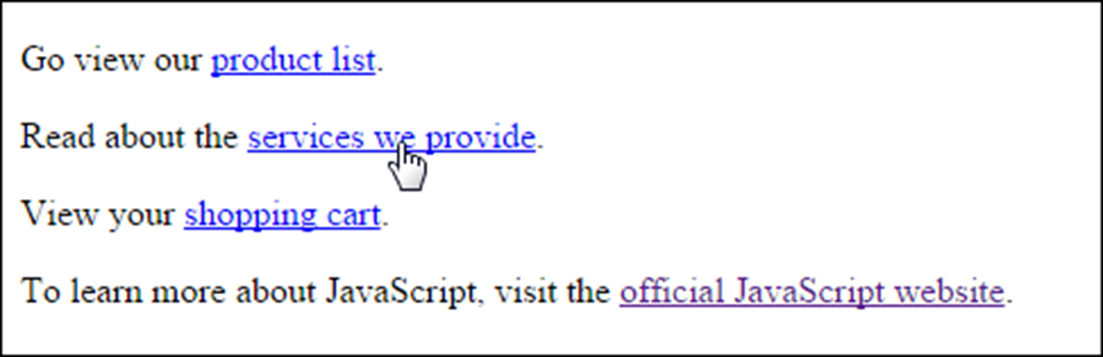
The link examples in a web browser
SEO and accessibility guideline for links
The content of a link should be text that clearly indicates where the link is going.
Murach's HTML and CSS, 5th Edition
© 2022, Mike Murach & Associates, Inc.

Slide 29
HTML that creates two lists
<p>We have books on a variety of languages, including</p>
<ul>
<li>JavaScript</li>
<li>PHP</li>
<li>Java<li>
<li>C#</li>
</ul>
<p>You will need to complete the following steps:</p>
<ol>
<li>Enter your billing information.</li>
<li>Enter your shipping information.</li>
<li>Confirm your order.</li>
</ol>
Murach's HTML and CSS, 5th Edition
© 2022, Mike Murach & Associates, Inc.
Notes:
How to code lists
Figure 3-9 shows how to code the two basic types of lists: ordered lists and unordered lists. To create an unordered list, you use the ul element. Then, within this element, you code one li (list item) element for each item in the list. The content of each li element is the text that’s displayed in the list. By default, when a list is displayed in a browser, each item in an unordered list is preceded by a bullet. However, you can change that bullet with CSS.
To create an ordered list, you use the ol element, along with one li element for each item in the list. This works like the ul element, except that the items are preceded by numbers rather than bullets when they’re displayed in a browser. In this case, you can change the type of numbers that are used with CSS.
The two lists shown in this figure illustrate how this works. Here, the first list displays the names of several programming languages, so these items don’t need to reflect any order.
By contrast, the second list identifies three steps for completing an order. Because these steps must be completed in a prescribed sequence, they’re displayed in an ordered list.
When you work with the li element, you should be aware that it can contain text, inline elements, or block elements. For example, an li element can contain an <a> element that defines a link. In fact, it’s a best practice to code a series of links within an unordered list. You’ll see an example of that later in this chapter, and you’ll learn all about it in chapter 7.

Slide 30
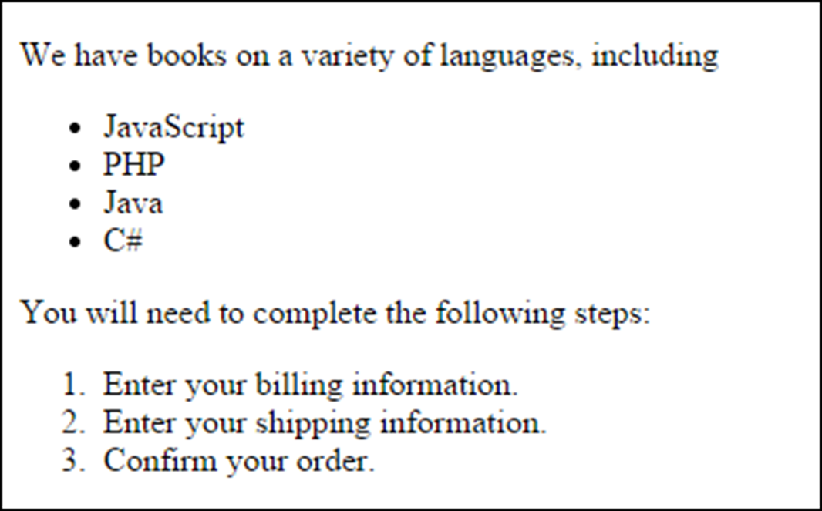
The lists in a web browser
Murach's HTML and CSS, 5th Edition
© 2022, Mike Murach & Associates, Inc.

Slide 31

An img element
<img src="images/murachlogo.gif" alt= "Murach Logo" height="75">
<h1>Mike Murach &amp; Associates, Inc.</h1>
The image in a web browser
Murach's HTML and CSS, 5th Edition
© 2022, Mike Murach & Associates, Inc.
Notes:
How to include images
Images are an important part of most web pages. To display an image, you use the img element shown in figure 3-10. This is an inline element that’s coded as an empty tag. In the example in this figure, this tag is coded before an h1 element. The h1 element is displayed below it, though, because it’s a block element that starts on a new line.
The src (source) attribute of an img element specifies the URL of the image that you want to display, and it is required.
For instance, the src attribute for the image in this example indicates that the image named murachlogo.gif can be found in the images subfolder of the current folder. The alt attribute should also be coded for img elements.
You typically use this attribute to provide information about the image in case it can’t be displayed or the page is being accessed by a screen reader. This is essential for visually-impaired users.
In this example, the image is our company’s logo, so the value of the alt attribute is set to “Murach Logo”. If an image doesn’t provide any meaning, however, you should code the value of the alt attribute as an empty string (""). You should do that, for example, when an image is only used for decoration. You can use the height and width attributes of an img element to tell the browser what the size of an image is.
That can help the browser lay out the page as the image is being loaded. Although you can also use the height and width attributes to render an image larger (known as “stretching”) or smaller than the original image, it’s better to use your image editor to make the image the right size. You’ll learn more about working with images in chapter 11.

Slide 32
Common image formats
JPEG (Joint Photographic Experts Group)
GIF (Graphic Interchange Format)
PNG (Portable Network Graphics)
Accessibility guidelines for images
For images with useful content, always code an alt attribute that describes the image.
For images that are used for decoration, code the alt attribute with no value ("").
Murach's HTML and CSS, 5th Edition
© 2022, Mike Murach & Associates, Inc.

Slide 33
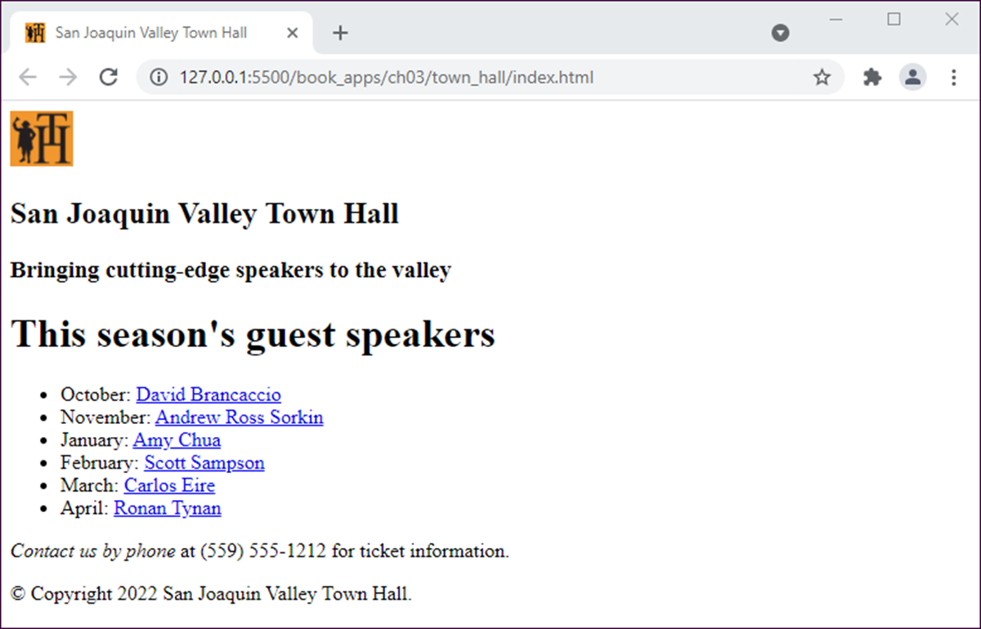
A simple web page
Murach's HTML and CSS, 5th Edition
© 2022, Mike Murach & Associates, Inc.
Notes:
A structured web page
Now that you’ve seen the HTML elements for structuring a web page, figure 3-11 presents a simple web page that uses these elements.
The page layout
The purpose of the web page in this figure is to provide information about a series of lectures being presented by a non-profit organization. It shows the default formatting for the HTML that’s used for this page. In the next chapter, though, you’ll learn how to use CSS to improve the formatting of this page.

Slide 34
The HTML file for the web page
<!DOCTYPE html>
<html lang="en">
<head>
<meta charset="utf-8">
<title>San Joaquin Valley Town Hall</title>
<link rel="shortcut icon"
href="images/favicon.ico">
</head>
<body>
<header>
<img src="images/logo.jpg" alt="Town Hall Logo" width="50">
<h2>San Joaquin Valley Town Hall</h2>
<h3>Bringing cutting-edge speakers to the
valley</h3>
</header>
Murach's HTML and CSS, 5th Edition
© 2022, Mike Murach & Associates, Inc.
Notes:
The HTML file
The HTML for this web page starts with the DOCTYPE declaration, the html element, and head element. They illustrate the way these items should be coded for every web page that you create.
In the html element, you can see the use of the lang attribute. In the head element, you can see the coding for the charset meta element, the title element, and a favicon.
Although it isn’t’ shown here, you should also include a meta element for the description in most web pages.
In the body element, you can see the use of the structural elements. Here, the header element contains one h2 element.

Slide 35
The HTML file for the web page (continued)
<main>
<h1>This season's guest speakers</h1>
<nav>
<ul>
<li>October:
<a href="speakers/brancaccio.html">
David Brancaccio</a></li>
...
...
</ul>
</nav>
<p><em>Contact us by phone</em> at (559) 555-1212 for ticket information.</p>
</main>
<footer>
<p>&copy; Copyright 2022 San Joaquin Valley Town Hall.</p>
</footer>
</body>
</html>
Murach's HTML and CSS, 5th Edition
© 2022, Mike Murach & Associates, Inc.
Notes:
The main element contains one h1 element, a nav element, and a <p> element. And the footer element contains one <p> element. Within the nav element is an unordered list that contains five li elements (although the HTML is shown for only two of them).
Then, each li element contains an <a> element. This is a best practice because a nav element should contain a series of links. It is also a best practice to code the <a> elements within an unordered list.
You can also see the use of an <em> element that italicizes the first four words in the <p> element within the main element and a character entity that inserts the copyright symbol into the <p> element within the footer. But what’s most important in this example is the use of the HTML structural elements and HTML semantics. That’s good for the developer as well as for search engine optimization.

Slide 36

Short 3-1 Create an HTML page
Murach's HTML and CSS, 5th Edition
© 2022, Mike Murach & Associates, Inc.

